Slide 1
WWW & Network Programming

Slide 2
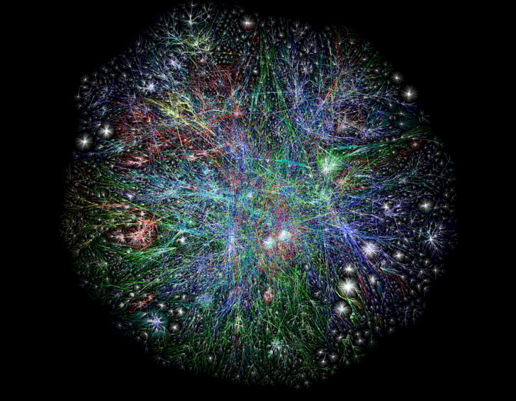

Slide 3
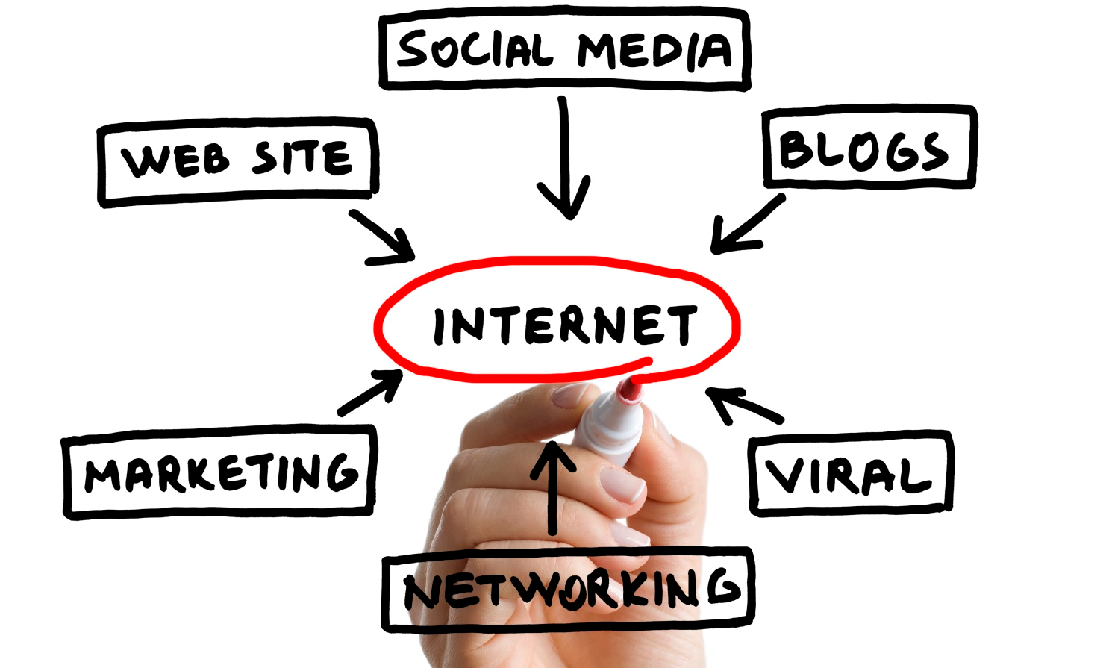

Slide 4
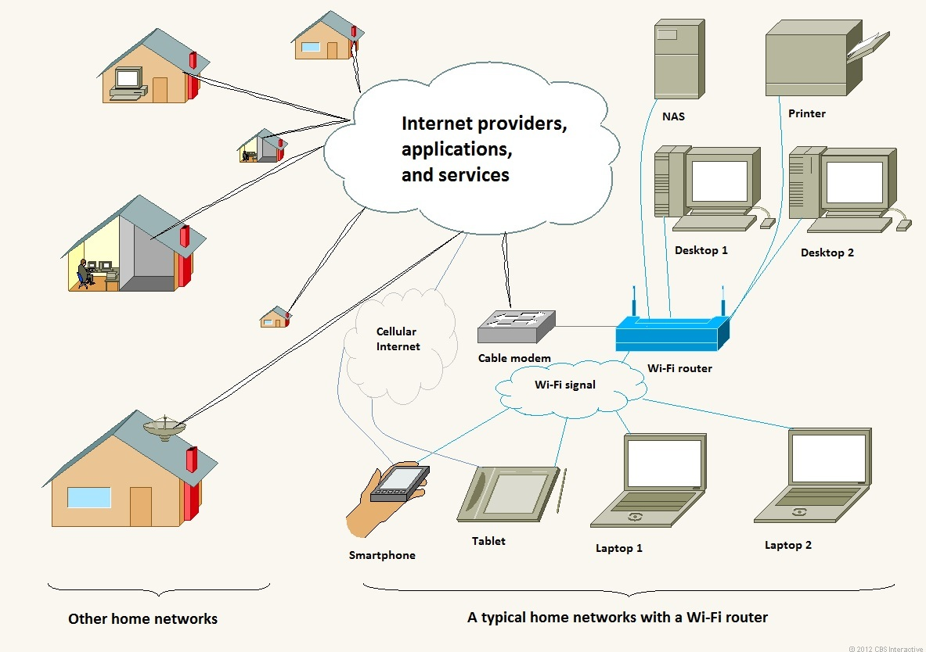

Slide 5
VPN

Slide 6
Who is responsible for this “connectivity”?
http://www.computerhistory.org/internet_history/index.html
W3C
Embed Tweet
Tim Berners-Lee‏@timberners_leeMar 12
I invented the WWW 25 years ago and I am concerned and excited about its future. Reddit AMA at 3pm Eastern. http://www.reddit.com/r/IAmA/comments/2091d4/i_am_tim_bernerslee_i_invented_the_www_25_years/ …
11:47 AM - 12 Mar 2014 · Details

Slide 7
Top Level Domains
http://data.iana.org/TLD/tlds-alpha-by-domain.txt
http://www.icann.org/
The “Dots”
.com, .edu, .mil, .org, .gov, . …

Slide 8
Network Layers
Application Level
(FTP, Telnet, etc.)
Transport Layer
(TCP, UDP, sockets, etc.)
Network Layer
(Low-level Protocol -- IP, datagrams, etc.)
Hardware Layer
(Ethernet, TokenRing, X.25, etc.)

Slide 9
Headers
http://nmap.org/book/tcpip-ref.html

Slide 10
Ports
http://www.iana.org/assignments/service-names-port-numbers/service-names-port-numbers.xhtml

Slide 11
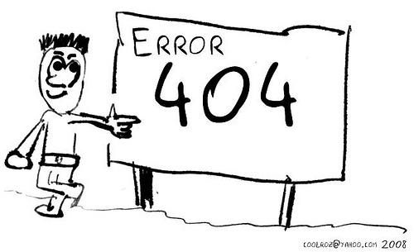
Http Error Codes
http://www.w3schools.com/tags/ref_httpmessages.asp

